Slide 1
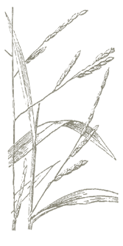
Water Demands for Mining
Richard Lowerre
Adapted from presentation to Texas Groundwater Summit
September 2013
Notes:
While the demands for Texas water by mining are not large compared to other demands, an analysis of the development of projections for demands and needs provides an example of the failure of the regional and state water planning process to collect and use the type of accurate data needed for a state water plan.
For planning purposes, water demands for mining include oil and gas activities, as well as those demands for coal, uranium, rock, sand, gravel and other traditional mining activities.

Slide 2
Statewide Water Demands
Notes:
The total amount of water for all mining activities, including oil and gas exploration and production, made up about 2% of statewide water use in 2010. It is projected to be about 2% by 2060, rising to 3% in between 2010 and 2030 before falling back by 2040. The predicted expansion of fracking is the reason for a rise in demands in the next 20 years.
While that is a small percentage of state water uses, the demands for water for mining certainly can be significant on a local level. Even where water use for mining is significant, Texas does a poor job of quantifying the demands, however.

Slide 3
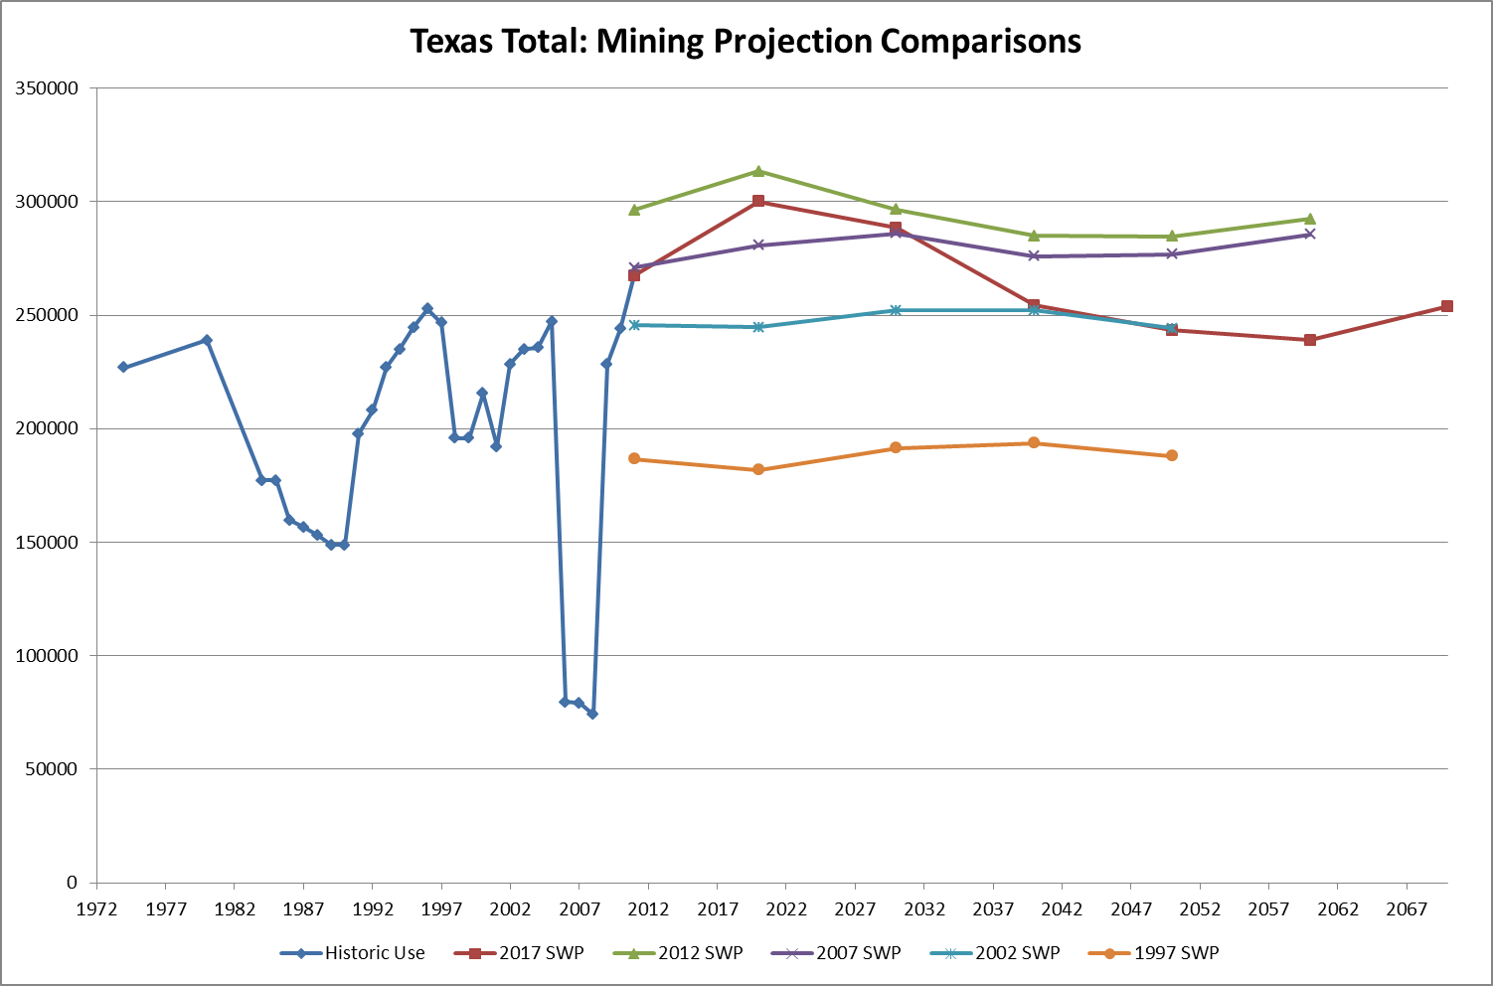
Notes:
The state's efforts to project the demands for water for mining have varied wildly.
Those projections doubled from 1997 (the orange line) to 2012 (the green line).
The new TWDB projections which are the starting point for the 2016 regional plans the red line) show a drop from the 2012 projections.
The historic use figures, in blue, show wide variability and are not likely to provide much help in projecting future demands. Moreover, the lack of data collection on actual uses in the past makes the accuracy of these historic figures doubtful.

Slide 4
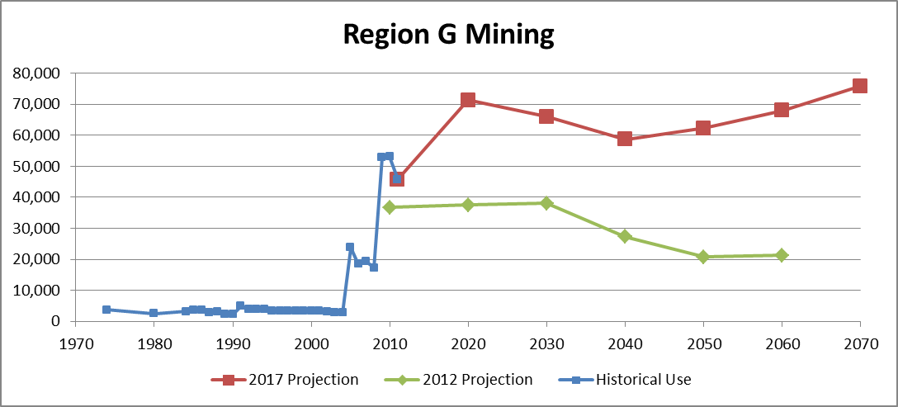
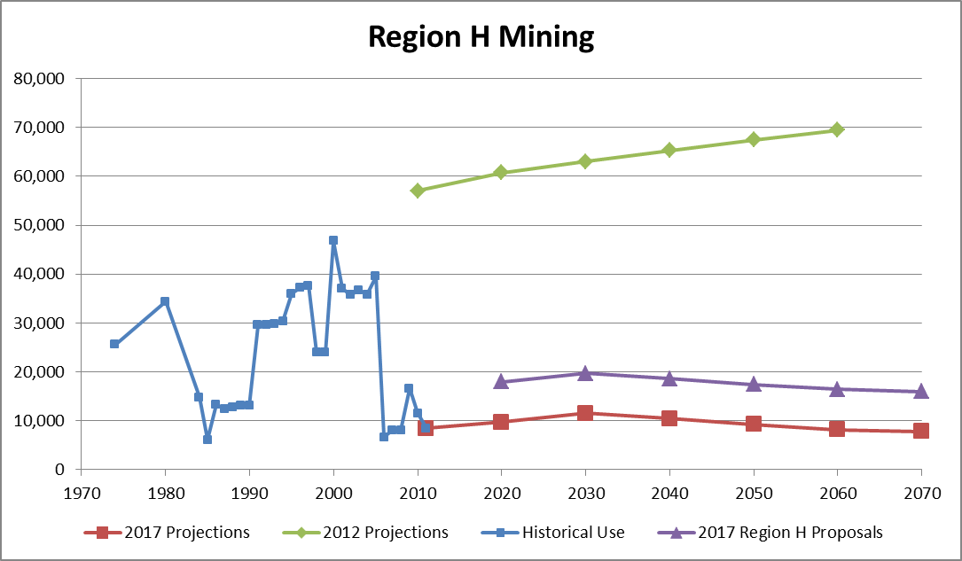
Notes:
Statewide projections are made up of a compilation of projections from 16 regions. The problems in projections at the regional level highlight the uncertainties in the statewide projections.
In the 2012 plan, two regional projections for mining demands make good examples. These two planning processes show significant changes from the 2012 projections in green to the more recent initial TWDB projections for the 2017 state water plan in red. The Region H chart also shows in purple what that region proposed back to TWDB for the 2017 plan.
For Region G, the 2012 water projections are about 50% of the new projections. For Region H, the TWDB new projections are about 10,000 acre feet per year, with Region H’s proposal of just under 20,000 acre feet per year. Both are well below the 60,000 to 70,000 acre-feet per year projected just a few years ago in the 2012 state plan.
The basis for that proposed change by Region H to increase TWDB’s projection is a change in the projections in Chamber County. In its explanation for its request to increase the demands, Region H’s consultants stated:
The [Region] recommended using the average of Water Use Survey estimates for the 2005-2009 (a demand of 8201 ac-ft/yr) as a level projection through 2070.
In other words, the projection was not based on projected demands, but a few years of past reported use. This 8201 demand figure was then just added for each decade. Clearly, these types of projections are almost no more than guesses. There was no effort to collect data on what the mining industries projected as increases or decreases in production or water demands.
These types of approaches to projections, together with the fact that mining water use is less than 2% of the overall water demands, might suggest that very little attention should be given to tracking the use or projecting for future uses. The money spent to collect the data might be better spent on other work.

Slide 5
County | Demands 2060 Mining | All demands 2060 | % mining
Robertson | 19000 | 129000 | 14.73%
Wise | 15000 | 38000 | 39.47%
Comal | 14000 | 67500 | 20.74%
Limestone | 10500 | 59000 | 17.80%
Williamson | 10000 | 223000 | 4.48%
Bastrop | 9000 | 74000 | 12.16%
Burnet | 8000 | 25000 | 32.00%
Notes:
In some counties, however, the amount of water used for mining is significant in relationship to total demands for water.
And, of course, there can be even more significant water use issues closer to where the water is produced for mining activities.

Slide 6
Needs for Mining Water and All uses in 2020
Mining Needs Total Needs
Region I ~30,000 ~83,000
Region N ~ 8,000 ~ 14,000
Unmet Needs for Mining Water Identified in the 2012 Water Plan
          2010 2020 2030 2040 2050 2060
Region I 7,772 8,620 9,191 9,760 10,333 10,772
Region N 1,591 2,448 3,023 3,374 3,660 3,876
Notes:
Moreover, in a number of regional plans, the projected needs for additional water for mining are significant drivers to develop strategies for obtaining additional sources of water. Thus, these water needs add to the overall projected costs of the state water plan.
In Region I, for example, the projected need in 2020 is for 30,000 acre-feet per year of new water, more than one-third of the 83,000 acre-feet per year, which is Region I’s total projected needs that year.
In Region N, the projected need of 8000 acre-feet of new water per year in 2020 makes up over 50% of the 2020 total need projected for that region.
As is shown in the lower table, both regions also project unmet water needs for mining for 2010 and into the future. These two regions and others have not yet determined how they obtain water for such unmet needs.

Slide 7
Example of Sources for Use and Demand Data
TWDB: Surveys for all mining
Chapter 16, Tex. Water Code, § 16.012(m)
  Ground water districts: For groundwater for most mining:
  Chapter 36, Tex. Water Code. § 36.111
  Railroad Commission for oil and gas and coal mining
  Chapter 36, Tex. Water Code Ann. § 36.117
  Railroad Commission and Texas Commission on Environmental Quality for Uranium Mining:
    Chapter 27 Tex. Water Code § 27.024
  Chapter 131 Nat. Resources Code § 131.354
Notes:
One key question is whether TWDB, other state agencies, ground water districts or others have the authority to collect the data needed to determine actual uses and other data needed to project the water demands for mining activities.
The laws listed above and others make it clear: they do.
Unfortunately, these entities are not using those laws effectively. There certainly are limits on funding for such data collection, but a coordinated and determined effort could provide the data at reasonable costs.

Slide 8
Survey Authority to the TWDB
Section 16.012(m) Tex. Water Code Provides:
[TWDB] may conduct surveys of entities using groundwater and surface water for municipal, industrial, power generation, or mining purposes at intervals . . . to gather data to be used for long-term water supply planning.
Recipients of the survey shall complete and return the survey . . . .
A person who fails to timely complete and return the survey is not eligible for funding from the board for board programs and is ineligible to obtain permits, permit amendments, or permit renewals from the commission under Chapter 11.
A person who fails to complete and return the survey commits an offense that is punishable as a Class C misdemeanor.
Notes:
TWDB is authorized to collect the data needed through surveys for mining and a number of other activities. It is important to note that TWDB is not limited to collecting past use information. It can gather other data needed for long-term water supply planning. That might be industries or utilities’ projections of future production, which drives water use. The surveys from TWDB, however, have only asked for past use data. TWDB does not ask those surveyed about their projected water uses or projected changes in production that could indicate changes in water uses.
The report of the Bureau of Economic Geology in 2011 on water use in mining makes it clear, however, that even surveys of past use have not been adequate. (See “Current and Future Water Use in the Texas Mining and Oil and Gas Industry,” http://www.beg.utexas.edu/water-energy/docs/Report_TWDB-MiningWaterUse_9.pdf. ) BEG stated, in essence, that it could not rely on the data collected by TWDB surveys alone since only 50 to 60 percent of the TWDB surveys were returned. That is despite the penalties that could apply.
TWDB did not and has not exercised its authority to seek criminal penalties for failure to provide responses. It does hope for voluntary compliance and is finding some benefit in the provision that limits on TWDB funding or TCEQ permits would create the incentives to respond. Thus, apparently some applicants for TWDB or TCEQ action have been told that the agencies cannot proceed with the applications until the surveys are submitted. There are not, however, many instances of this process providing surveys, and fewer yet that result in timely survey responses.
TWDB is now reporting better compliance with its surveys.
Surveys for mining use, however, are done only once every 5 years; surveys for other uses are done annually. Surveys for mining water demands have not been performed again since those used by BEG in its 2011 report. Thus, the 2017 water plan are continuing to rely on the pre-2011 TWDB surveys, a 2012 BEG update on oil and gas use (http://www.beg.utexas.edu/water-energy/docs/Final_Report_O&GWaterUse-2012_8.pdf ) and other sources of information, such as informal communications between BEG and trade associations or members of the mining industries.

Slide 9
Reports for Surface Water Use
ANNUAL REPORT. Section 11.031. Tex. Water Code
(a) Not later than March 1 of each year, each person who has a water right issued by the commission or who impounded, diverted, or otherwise used state water during the preceding calendar year shall submit a written report to the commission on a form prescribed by the commission.
(b) A person who fails to file an annual report with the commission as required by this section is liable to a penalty of $25, plus $1 per day for each day he fails to file the statement after March 1. However, the maximum penalty under this section is $150. The state may sue to recover the penalty.
(d) Each person who has a water right issued by the commission or who impounds, diverts, or otherwise uses state water shall maintain water use information required under Subsection (a) on a monthly basis during the months a water rights holder uses permitted water. The person shall make the information available to the commission on the commission's request.
Notes:
Most surface water that is used in oil and gas activities, coal and other mining that is not ground water is used pursuant to water right permits issued by TCEQ or pursuant to contracts for the purchase of the water from river authorities or others with surplus water. Pursuant to Texas Water Code, TCEQ can and does require annual reports on such uses and copies of contracts for sale. The accuracy of resulting water use figures is again questionable, since TCEQ does not require accurate metering of water use and it does no, or almost no, enforcement for failure to file accurate reports on the amount of water used or even failure to reports at all.

Slide 10
Reports to Groundwater Conservation Districts
Records and Reports: Section 36.111 Tex. Water Code
The district may require that records be kept and reports be made of the drilling, equipping, and completing of water wells and of the production and use of groundwater.
In implementing Subsection (a), a district may adopt rules that require an owner or operator of a water well that is required to be registered with or permitted by the district, except for the owner or operator of a well that is exempt from permit requirements under Section 36.117(b)(1), to report groundwater withdrawals using reasonable and appropriate reporting methods and frequency.
Notes:
The general language of the law under Chapter 36 provides groundwater districts with broad authority to collect accurate data on ground water use for mining. There are exceptions, but the districts can require reports on ground water use for almost all mining activities. GCDs can require meters for and reporting of ground water pumping and uses. This authority applies to sand, gravel, rock and other such mining, to most oil and gas activities, and to coal and uranium.

Slide 11
Reports on Groundwater use by Coal Mines
Section 36.117, Tex. Water Code
(e) An entity holding a permit issued by the Railroad Commission of Texas under Chapter 134, Natural Resources Code, that authorizes the drilling of a water well shall report monthly to the [Groundwater Conservation] district:
  the total amount of water withdrawn during the month;
  (2) the quantity of water necessary for mining activities; and
  (3) the quantity of water withdrawn for other purposes.
Notes:
While most water wells for coal mining are exempt from regulation by GCDs under Section 36.117, mining companies are still required to report on their water withdrawal and use.

Slide 12
Groundwater Reports For Uranium Mining
For exempt exploratory wells: Section 131.354 Tex. Nat. Resources Code
(c) A well described by Section 131.353(c) is subject to a groundwater conservation district's rules for registration, production, and reporting if:
  (1) the well is located in the groundwater conservation district and the well is used for rig supply purposes; and
  (2) the cumulative amount of water produced from the wells located inside the area subject to the exploration permit and completed under the exploration permit issued under this subchapter exceeds 40 acre feet in one year.
(d) Each month, the holder of an exploration permit governing a well described by Section 131.353(c) and located in a groundwater conservation district shall report to the district the total amount of water produced from each well described by Section 131.353(c)…
For other wells, Section 27.024, Tex. Water Code
SHARING OF GEOLOGIC, HYDROLOGIC, AND WATER QUALITY DATA. (a) …for an area permit for an area located in a groundwater conservation district has identified a permit boundary, the person shall provide to that district . . .
(4) on a monthly basis, the amount of water produced from the wells described by Section 27.023(a); …
Notes:
Likewise, for uranium mining, for which some activities are exempt from some GCD regulation or permit requirements, withdrawal and use data is still required to be reported.

Slide 13
CONCLUSION
This analysis of the data collection for water demand projections for mining is disturbing. It data collection for other sectors is similar, the State Water Plan has to be viewed with significant skepticism.
Given the percentage of total state water used for mining, data collection for mining may not be a priority. Even if it is not a priority statewide, it should be in some regions.
TWDB and others could use existing law to improve significantly the quality of the data available, for both past use and the other information needed to project future demands.
Accurate data collection needs to be a priority if the state water plan is going to help solving future water needs in an efficient manner.

